Slide 1


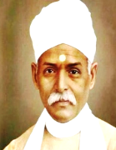

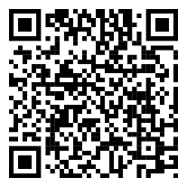
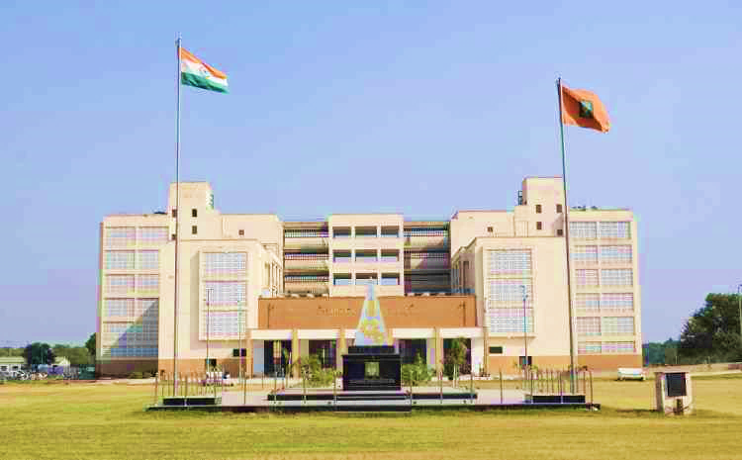
About Central University of Punjab
The Central University of Punjab was established in 2009, along with 12 other Central Universities, by an Act of Parliament (No. 25 of 2009). The university's mission is to provide various instructional and research facilities across integrated and cross-disciplines, promote teaching, learning, and research innovation, and cross-pollinate new ideas, technologies, and world-views.
About Malaviya Mission Teacher Training Centre
The Malaviya Mission Teacher Training Programme (MMTTP) has been re-launched by restructuring existing mechanisms to enhance the capacity and training of teachers/faculty. The mission aims to transform higher education by integrating Indian values and ethos into teaching, research, publications, patents, and institutional development.
BENEFIT
This programme shall be taken into consideration for fulfillment of the requirements as laid down in Career Advancement Scheme of UGC.
WHO CAN APPLY
Faculty members (Permanent, Contractual, Ad-hoc) working in universities and colleges that are included under Section 2(f) of the UGC Act. The teachers of colleges that do not yet come within the purview of Section 2(f), but have been affiliated to a university for at least three years, will be permitted to participate in the courses.
IMPORTANT DATE
Course Date: 12th to 17th October, 2026
Last Date of Registration: 8th October, 2026
Email Confirmation : 10th October, 2026
Duration of Course: 36 Hours (Mon to Sat)
Online Platform: Google Meet
HOW TO APPLY
No Registration fee.
Register yourself on https://mmc.ugc.ac.in
Go to MMTTP Dashboard Click on – “Apply for Guru Dakshta (Faculty Induction Programme), Refresher Course and Short Term Programme / Faculty Development Programme”
Center Name: “Central University of Punjab”
4. Fill the details and Upload “NoC letter”.
5. NoC Letter format and Step by Step Registration process is available on MMTTP Website.
Course Coordinator:
Prof. Aklank Jain
Department of Zoology, Central University of Punjab
Course Co-Coordinator:
Dr. Raman Tikoria
Department of Zoology, Central University of Punjab
Programme Director
Dr. Vinod Arya
Director, MMTTC
Central University of Punjab
For more details visit: https://cup.edu.in/mmttc
Official Email: mmttc@cup.edu.in
For Any Query Contact No. :
(M): +91 7404148910 & +91 9816427691
ONE-WEEK
SHORT TERM PROGRAMME (Online)
on
“Advances in Life Sciences: Emerging Trends, Innovations, and Future Perspectives”
12th to 17th October, 2026
In collaboration with
Department of Zoology
Central University of Punjab
Organized by
MALAVIYA MISSION TEACHER TRAINING CENTRE
CENTRAL UNIVERSITY OF PUNJAB
(Under Malaviya Mission Teacher Training Programme of University Grants Commission, Ministry of Education, Government of India)

